Slide 1
Cloud Computing - Basic Architecture

Slide 2
OK, Cloud Sounds Good, Now What?
Continuing the electric power analogy, how do we have to design our software (motors and other consumers of electricity) to run on this nice cloud platform (power generation and transmission network) over which we, the customers, have very little detailed control (must use available voltages, frequencies, etc.)?

Slide 3
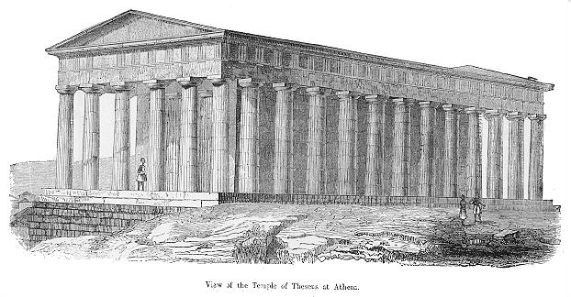
Software Architecture Evolution

Slide 4

Mainframe Architecture
Approach
  Mainframe provides all resources and logic
  Terminals for user interaction (thin clients)
Advantages
  Simple deployment
Problems and Limitations
  Limited GUI capabilities
  Every client allocates server resources →
  Limited scalability
Terminals: UI
Mainframe:
Application and Data

Slide 5
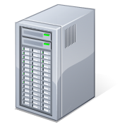
Client/Server Architecture
Approach
  Increased capabilities of PCs
  Logic partially transferred to clients
  Central database server
Advantages
  Better user experience (GUIs)
Problems and Limitations
  Client has permanent stateful connection
  Client holds server resources (db con, …) →Limited scalability
Thick Clients :
UI + Logic
Mac
Linux-Workstation
PC
Server: Data

Slide 6


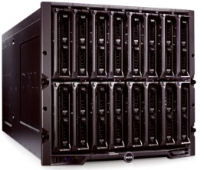
Middle-Tier Architecture
Approach
  Logic bundled in Middle-tier
  Clients have no permanent connection to Middle-tier → stateless connections
Advantages
  Middleware provides services (pooling, security, …)
  Resources shared between clients → improved scalability
Problems: new programming model
Thin Clients
Middle-Tier:
Logic + Services (Middleware)
Data-Tier

Slide 7
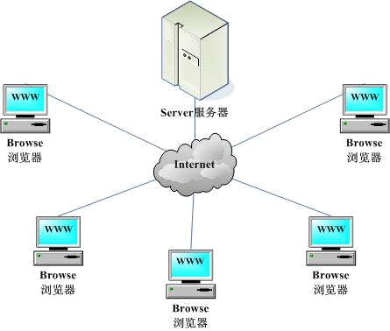
Browser Server Architecture
Extension of the mid-tier architecture
Expose functions through web services
Highly scalable
Network dependent
Stateless connection

Slide 8
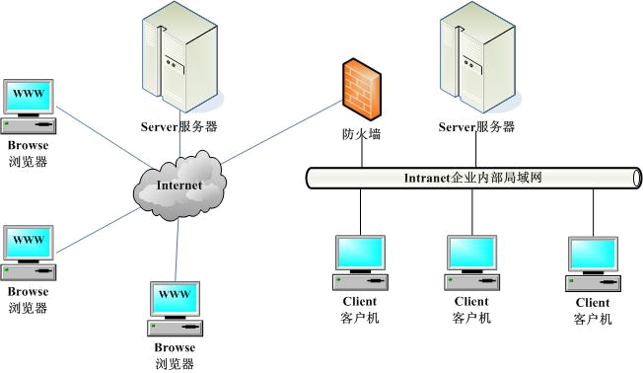
B/S-C/S Hybrid Architecture

Slide 9
Multi-Tier Cloud Software Architecture
Virtualization
Web services
Orchestra / service bus
Client-side interfaces
Client-side Interfaces
Expose cloud to clients
Orchestra/Service Bus
Bridge the cloud with users
Web Services
Stateless form of cloud services
Virtualization
Foundation for cloud

Slide 10
First Tier
Virtualization
dynamically increase and decrease computing capacity
can be achieved on many different layers of abstraction
  application server, operating system processes,
  virtual machines, logical partitions of physical hardware
For cloud computing - mostly logical machine level of abstraction

Slide 11
Second Tier
Web Services
access to cloud resources via WebService APIs (RESTful API)
APIs typically are hidden behind wrapper libraries
  Java, C#, C++ (and other .NET languages) for the client
  "web languages" such as Python, Ruby, and PHP

Slide 12
Third Tier
Orchestration / Service Bus
Compute services, data stores, and messaging middleware.
Platforms differ w.r.t. their support for integrating external services
  Be it hosted on premise or at partner sites

Slide 13
Fouth Tier
Clients-side user interfaces
Cloud computing applications need to expose a client-side UI
Portals integrate mashups in a web browser
  Simple user interfaces often based on Ajax and JavaScript
  Trend to fully fledged component model such as JavaBeans/Applets or Silverlight/.NET
  Downloadable and can be executed on the client's computer

Slide 14

Programming Models
Stateful vs. Stateless programming
Separation of cerncerns
  Dependence Injection
  Layered architecture
  Domain objects
Asychnorous message passing

Slide 15
Statelessness
It is expensive and difficult to maintain the connection from proxy to a specific server-side object from one call to the next. For example, load balancing is difficult, as is lifetime management.
So you generally want to design your objects so that they don’t expect their internal state to be maintained from one call to another. The proxy often stays alive on the client side, but is connected to a difference object instance on the server side on its next call.

Slide 16
Statelessness
Service Host
Client 1
t=0
Instance 1
Client 2
t=0
Proxy
Instance 2
Proxy
Instance 3
t=1

Slide 17
Statelessness
The term statelessness does not mean that no data is maintained from one call to the next. It does mean that no data is maintained in an individual object instance. Whatever data is maintained from one call to the next is maintained in some sort of storage system, so that the next object instance can pick up where the first left off.

Slide 18
Statelessness
Service Host
Client 1
t=0
Instance 1
Client 2
t=0
Proxy
Instance 2
Proxy
Instance 3
t=1
Object fetches previous state from storage when it is instantiated at the start of a call. It stores current state in storage when it is deactivated at the end of a call.

Slide 19
Chunkiness
Calls to local objects are very quick, call overhead is low.
In distributed system, call overhead is very much larger.
Therefore, it is important to make fewer calls, with more data in each call
Optimum level of chunkiness depends on application and will require experimentation EARLY in design process.

Slide 20
Message Passing
If client has to wait for server to finish processing, or even be alive at the same time as the server, we can wait a long time to get the job done
Often the client does best to leave a message about a job it wants done, then harvest the results later. Example: voice mail or text msgs vs. direct conversation.
Different programming model: no immediate output parameters. Output comes through another msg (again, like voice mail).

Slide 21
Message Passing
Client
Message
Message Broker
Service
Message
Instance 1
Queue
Instance 2
Client
Message

Slide 22
Cloud Architecture of
Different Vendors

Slide 23
Amazon Cloud Offering
Amazon Elastic Compute Cloud
You create Amazon Machine Images (their VM) containing your choice of OS (Linux or Windows)
You then run whatever programs you want, such as IIS, on that AMI (classic IaaS model)
Additional services, such as storage or payment processing, are available a la carte (see next lesson). These parts are PaaS

Slide 24

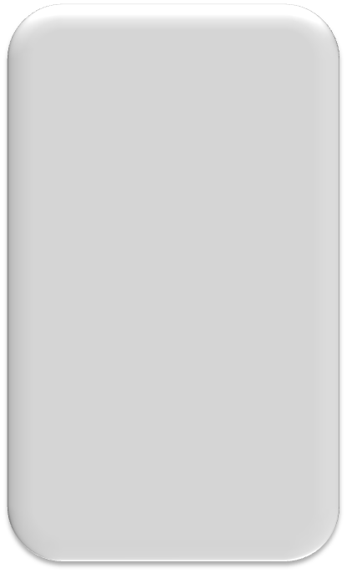


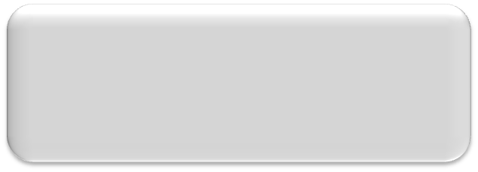

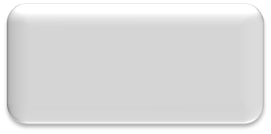








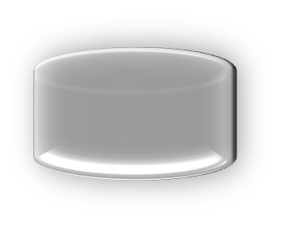
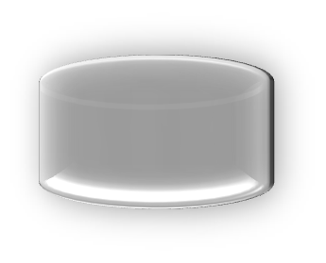


Google Cloud Offering
Stateless service APIs
Request/Response
URL Fetch
Mail
Python/Java
VM process
Stdlib
App
Images
Task Queues
Stateful service APIs
XMPP
Google Accounts
Memcache
Datastore
Blobstore

Slide 25
Google Cloud Offering
You write your app and plug it into Google App Engine, which handles HTTP(S) requests, nothing else. Think RPC: request in, processing, response out. Works well for the web and AJAX
App configuration is dead simple, no performance tuning needed
Everything is built to scale. “Infinite” number of apps, requests/sec, storage capacity. APIs are simple, stupid
Mostly IaaS, not so much PaaS

Slide 26
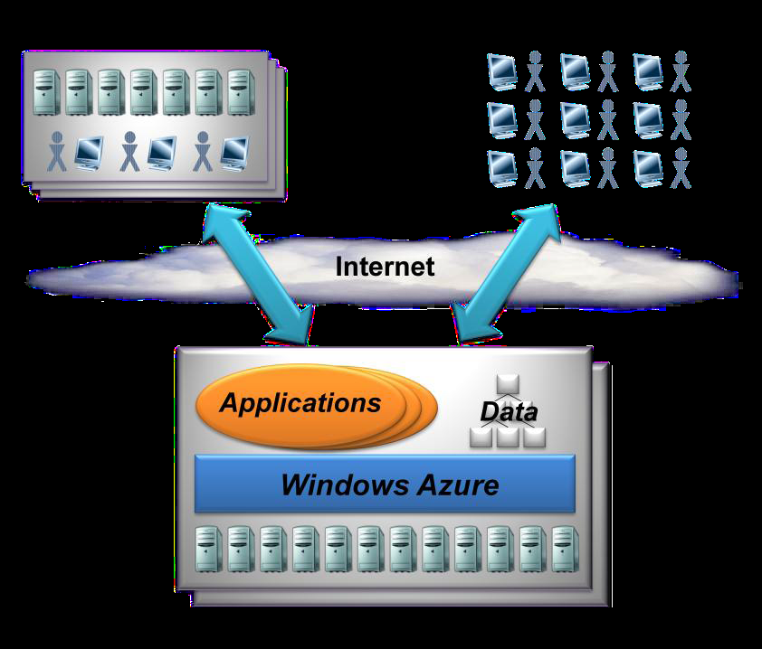
Azure Overview

Slide 27
Azure Overview
Application is the software built by the programmer. It does something useful for the user, who connects to it via the Internet
Azure runs on multiple Windows PCs in a data center. It is the layer that provides system services to the application. From the app’s point of view, this is the operating system.
I’d call this full PaaS.

Slide 28
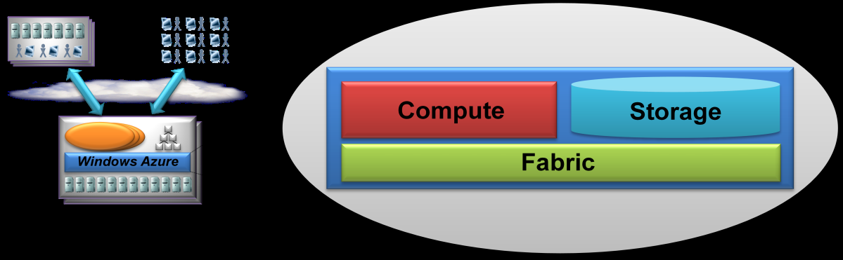
Inside the Azure Layer
Notes:
Chappell Figure 2, from page 4

Slide 29
Inside the Azure Layer
Compute service runs applications.
Storage service stores data in simple blobs, tables, and queues. Relational storage is available through SQL Azure
Fabric is the control, management, and monitoring service for Azure itself.

Slide 30
Inside the Compute Layer
Each compute instance (web role or worker role) runs in its own virtual machine.
Your service agreement specifies the number and size of VMs that you can run
Instance Size | CPU | Memory GB | Storage GB | I/O Perf
Small | 1.6 GHz | 1.75 | 225 | Moderate
Medium | 2 x 1.6 GHz | 3.5 | 490 | High
Large | 4 x 1.6 GHz | 7 | 1000 | High
Extra Large | 8 x 1.6 GHz | 14 | 2040 | High

Slide 31
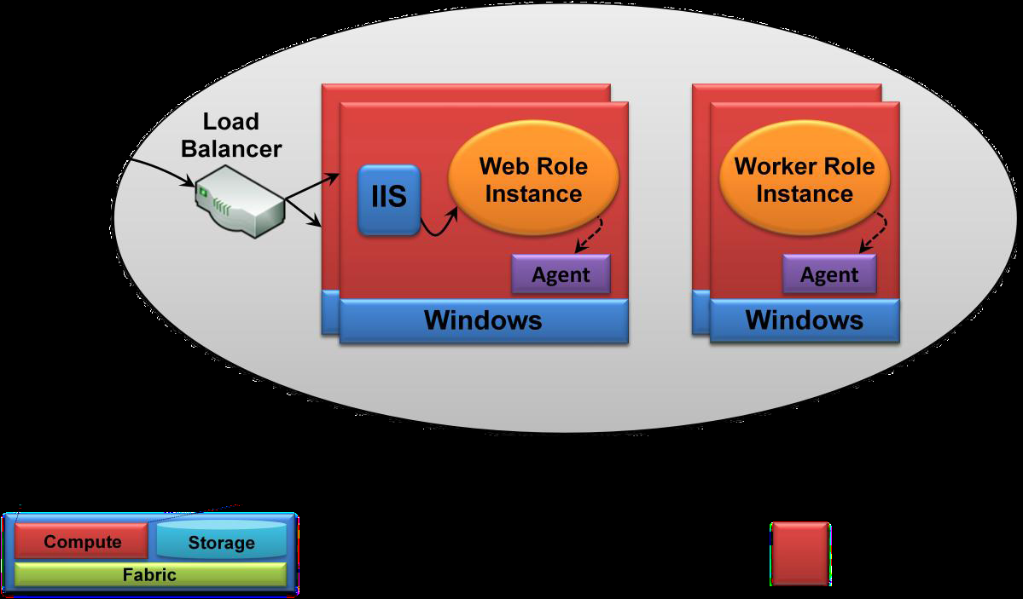
Inside the Compute Layer
Each VM contains a single role instance.
Notes:
Chappell Figure 3, page 5

Slide 32
Web Roles
A Web role is a computing object instance which is exposed to the outside Internet.
It runs in a VM containing IIS 7.
Can communicate with the outside world via ASP.NET, WCF, or any other .NET technology that works with IIS.

Slide 33
Worker Roles
A Worker Role is a computing object which is not exposed to the outside Internet
It runs in a VM which does not contain IIS.
Conceptually similar to a background processing job.
Worker roles may process requests queued by Web roles, or they may sift through large amounts of pre-stored data on their own.

Slide 34
Agent
Each compute instance contains an Agent which represents the application’s connection to Azure.
Provides simple API that lets a compute instance interact with the Azure Fabric.
Conceptually similar to the Context object in COM+, in that it provides connection to the environment in which it runs.

Slide 35
Usage Scenarios

Slide 36
Scalable Web Application
Many Web Roles to handle many users
Data stored in tables
Example: online multiplayer game

Slide 37

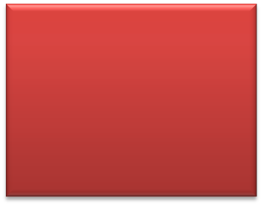


Pattern 1A
On-Premise LOB Application or Service bus leveraging scalable cloud storage
Blobs
Application or Service Bus
Tables
REST
Queues
Firewall

Slide 38





Pattern 1
Highly scalable dynamic HTML or RIA application leveraging scalable cloud storage
Web Roles
ASP.NET
ASP.NET
ASP.NET
ASP.NET
HTML or Silverlight
in the browser
Blobs
Queues
Tables

Slide 39
Parallel Processing Application
Many Worker Roles to process data and perform calculations
Data stored as blobs
One Web Role for control.
Roles communicate with each other via queues.

Slide 40
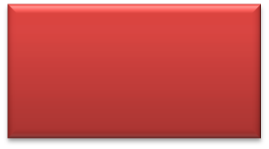

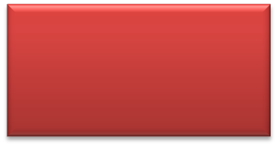
Pattern 2A
Highly scalable dynamic HTML or RIA application leveraging Azure Queues to pass messages to a background processing agent.
ASP.NET
Web Role
Queues
HTML or Silverlight
in the browser
Worker Role
Background Processing

Slide 41


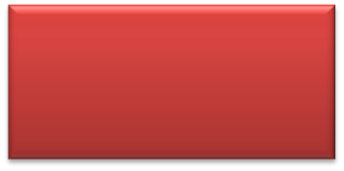
Pattern 2
Highly scalable dynamic HTML or RIA application leveraging Azure Queues to pass messages to a background processing agent.
ASP.NET
Web Role
Service
Queues
HTML or Silverlight
in the browser
Background Processing
Worker Role
Blobs
Tables

Slide 42
Blob Container
1. User uploads pictures to blobs
Picture Blob 1
4. Worker creates TN blob, places in container
Picture Blob 2
Thumbnail Blob 1
Web Role
Worker Role
Thumbnail Blob 2
0, 5 Web role displays thumbnails to user
Queue
“Make TN for new blob 2”
2. Web role puts msg in queue
3. Worker role fetches msg
Notes:
Try to make this less ugly please

Slide 43
Thanks!

